Slide 1


RECENT DEVELOPMENTS IN THE LAW OF GENERAL AVERAGE AND SALVAGE
V Bala
Partner, Rajah & Tann Singapore LLP

Slide 2
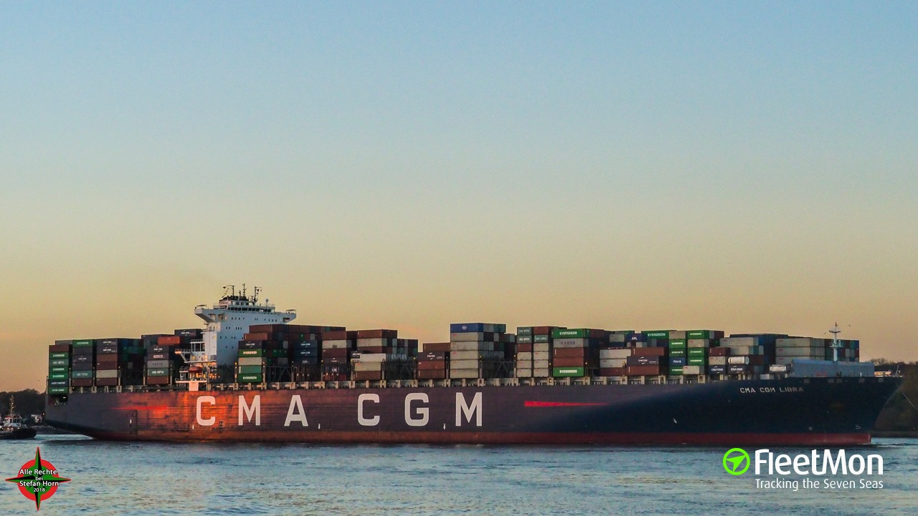
1. General Average Defences – Unseaworthiness
The CMA CGM LIBRA [2021] UKSC 51
Grounding of vessel.
General average claim against cargo owners for USD13 million.
Defence to general average contribution – loss/expenditure caused by Owners’ actionable fault pursuant to York-Antwerp Rules.
Owners failed to exercise due diligence to make the vessel seaworthy due to defective passage plan in breach of Hague Rules.

Slide 3
1. General Average Defences – Unseaworthiness
The CMA CGM LIBRA [2021] UKSC 51
Issue 1: Did the defective passage plan render vessel unseaworthy for the purposes of Article III Rule 1 of the Hague Rules?
No category-based distinction between the vessel’s quality of seaworthiness or navigability and crew’s act of navigating. Negligent navigation or management of vessel may cause unseaworthiness.
Article IV Rule 2 of the Hague Rules exceptions do not apply to a causative breach of the carrier’s obligation to exercise due diligence to make the vessel seaworthy under Article III Rule 1.
Prudent owner test, save in exceptional circumstances, remains an appropriate test of seaworthiness.
Negligent act in failing to note or mark uncharted depth warning in passage plan and working chart rendered the passage plan defective. Given the importance of passage planning for safety of navigation, the defective passage plan caused the vessel to be unseaworthy.

Slide 4
1. General Average Defences – Unseaworthiness
The CMA CGM LIBRA [2021] UKSC 51
Issue 2: Did the failure of the master and second officer to exercise reasonable skill and care when preparing the passage plan constitute want of due diligence on the part of the carrier for the purposes of Article III Rule 2 of the Hague Rules?
Carrier’s alternative argument that so long as the carrier has equipped vessel with all that was necessary for the safe navigation, the crew’s failure to safely navigate the vessel is not a lack of due diligence by the carrier.
Work of preparing proper passage plan to make the vessel seaworthy for voyage was entrusted to the master and deck officers, who are servants of the carrier.
Carrier’s seaworthiness obligation in relation to passage planning is not limited to providing a proper system for such planning; the carrier remains responsible for the crew’s failure to safely navigate the vessel.

Slide 5
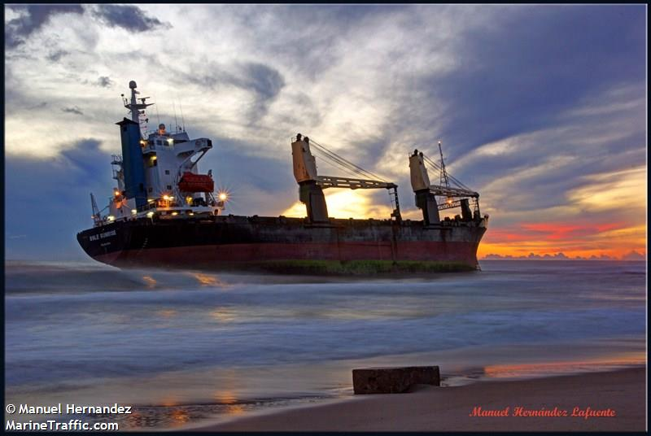
2. General Average Guarantee – Availability of “Actionable Fault” Defence to Issuer
The “BSLE Sunrise” [2019] EWHC 2860 (Comm)
Vessel ran aground off Valencia. Expenses incurred to re-float the vessel and carrying out temporary repair works.
Two GA Guarantees were issued by cargo insurers and two GA Bonds were issued by cargo interests.
Common ground that if the casualty event was caused by Owners’ breach of Article III Rule 1 of the Hague Visby Rules, no GA is due from cargo interests pursuant to Rule D of York-Antwerp Rules.
Issue: Whether same defence was available to insurers in relation to their liability under the GA Guarantees?

Slide 6
2. General Average Guarantee – Availability of “Actionable Fault” Defence to Issuer
The “BSLE Sunrise” [2019] EWHC 2860 (Comm)
Language used by parties indicated that the GA Guarantees were intended to operate in conjunction with or to go hand in hand with, and not in effective substitution for, the GA Bonds.
While the GA Guarantee created a primary obligation between the issuer and owner, such an obligation would not be greater, wider or more onerous than the obligations between the owner and cargo interest under the GA Bond.
No practical purpose for Owners to seek issue of GA Bonds from cargo interests if the intended effect of the GA Guarantees was to create an obligation for cargo insurers to pay regardless of cargo interests’ ultimate liability.

Slide 7
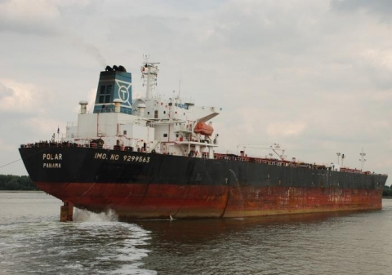
3. General Average Contribution – Liability For War Risks / K&R Losses
The “Polar” [2021] EWCA Civ 1828
Claim by Owners and subrogated insurers for contribution in general average from cargo interests and their subrogated insurers.
GA expenditure – ransom payment of USD7 million to secure release of the vessel after her seizure by pirates in the Gulf of Aden, which owners claimed from cargo interests under a GA bond and guarantee.
Bill of lading incorporated series of terms in voyage charterparty, including war risk clause and Gulf of Aden clause.
Cargo interests defence – bills of lading precluded claim for contribution in general average from cargo interests, as it incorporated series of terms in voyage charterparty to the effect that owners agreed to look exclusively to their insurers.
Court of Appeal held the bills of lading did not exclude cargo interests’ liability to pay contribution – the risk of piracy and the potential need to pay a ransom were foreseeable and indeed foreseen by the parties to the bill of lading contract and dealt with expressly by them.

Slide 8
4. Implementation of Salvage Convention in Singapore
No cure, no pay principle.
Special compensation in Salvage Convention for minimising or preventing environmental damage even if ship or cargo not salved.
Salvage Convention implemented in Singapore on 24 July 2021.
Singapore High Court’s admiralty jurisdiction expanded to include any claim under the Salvage Convention as well as under any contract for or in relation to salvage services.
Salvage companies able to enforce salvage claims seated in foreign jurisdictions in Singapore by ship arrest in aid of foreign arbitration.

