Slide 1
The “new normal” – what is it and how do we prepare for it?
IBA 6th Asia Law Firm Management Event
Leadership Masterclass
Moderated by
Jerry K C Koh Managing Partner, Allen & Gledhill 3 June 2022

Slide 2
Speakers
Panellists
Patrick Ang
Rajah & Tann, Singapore
Carlos de Cárdenas
Uria, Madrid
Praveen Tekchandani
Ernst & Young, Singapore
Sophie Mathur
Linklaters, Singapore
Moderator
Jerry K C Koh
Allen & Gledhill, Singapore

Slide 3
Key Themes
The “New Normal” and the Future of Work
Technology
Sustainability
Talent
Conclusion

Slide 4
The “new normal” and the future of work

Slide 5


The “new normal” and the future of work
Steady progress to a new, COVID-resilient normal
National shift to a “Living with COVID-19” strategy
Singapore lowered its Disease Outbreak Response System Condition (DORSCON) level from Orange to Yellow from
26 April 2022 – the first time in more than two years
Return of both business travellers and tourists
  Fully vaccinated travellers permitted to enter Singapore without taking any COVID-19 tests
No group size limits
All employees may return to the workplace

Slide 6

The “new normal” and the future of work
Economy
Singapore economy on an upward trajectory, although uncertainties remain in the long term
Singapore’s economy expanded 7.6% in 2021, according to Ministry of Trade and Industry (“MTI”)
1Q2022 GDP: 3.4% growth year-on-year
  Strong output growth from electronics and precision engineering clusters, driven by demand for semiconductors
  Expansion of information & communications sector boosted by strong demand for IT and digital solutions
MTI’s 2022 GDP growth forecast for Singapore: “3.0 to 5.0 per cent”

Slide 7
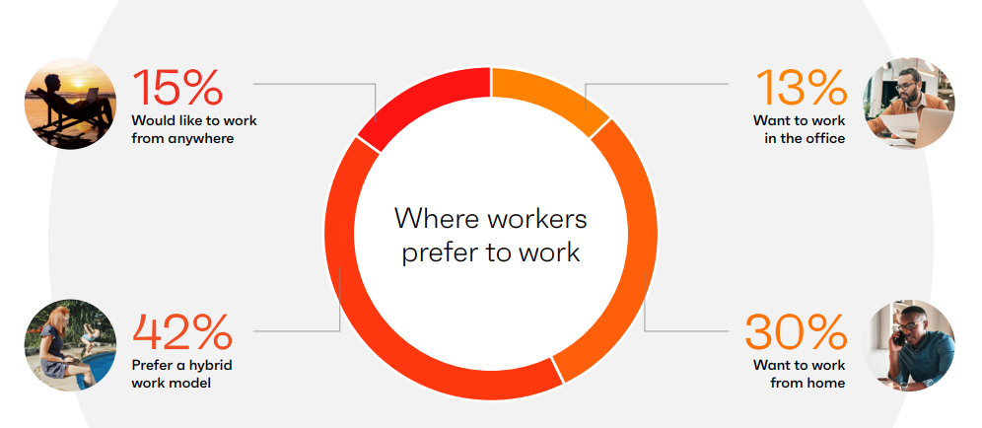
The “new normal” and the future of work
Verdict is still out on the future of work
With easing of restrictions, many organisations have begun their transition back to the office
Some companies are exploring hybrid model of work on a more long-term basis
Others are reconfiguring offices and/or reducing physical space
Ivanti’s 2022 Everywhere Workplace Report:
  42% prefer hybrid work model
  13% want to work in the office
Source: Ivanti, 2022 Everywhere Workplace Report.

Slide 8

The “new normal” and the future of work
Verdict is still out on the future of work
  Senior management of a number of top banks and listed companies have shown excitement about returning to the office
  Invaluable benefits of physical offices (face-to-face interactions; personal touch)
  Junior employees have their own concerns with remote work
  Decreased mentorship
  Reduced training opportunities
Singapore Government encourages permanent flexible work arrangements (“FWAs”)
  Public service to take the lead – eligible public officers in roles conducive to hybrid work can telecommute for an average of two days a week
  “Trust should also be maintained between employers and employees, through regular and open communication to discuss on what FWAs are practical and sustainable, and the organisational outcomes and deliverables that need to be met.” – Tripartite Statement on Flexible Work Arrangements (22 April 2022)

Slide 9
The “new normal” and the future of work
Panel Discussion

Slide 10
Technology

Slide 11
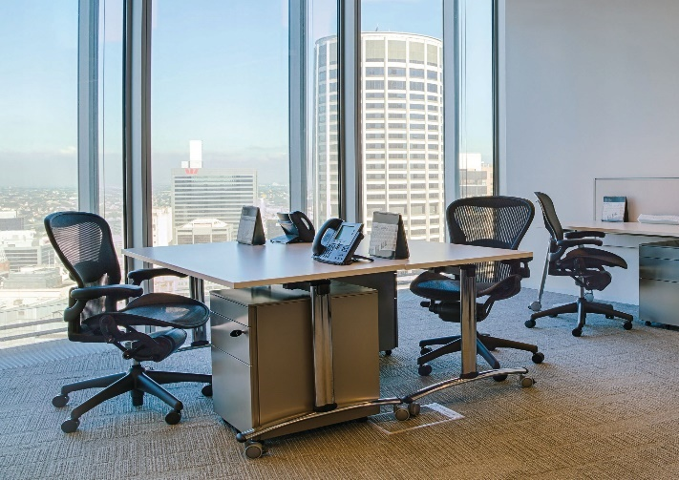
Technology
Organisations are leveraging IT to promote business continuity and enhance efficiency
Greater focus on cloud computing – speed up processes and increase flexibility in work
  Requires significant investments by the organisation
  High levels of coordination needed for digital transformation
Digitalisation of processes and protocols
  Usage of electronic platforms to perform tasks
  (e.g. DocuSign)
  Higher reliance on mobile working tools
  (e.g. laptops, phone apps)
  Automation of simple or repetitive tasks
Overall, making jobs more efficient

Slide 12
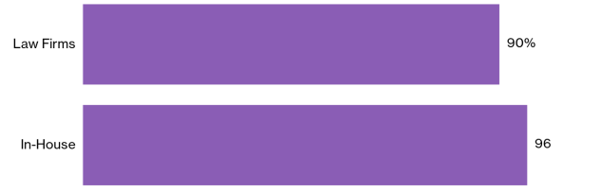
Technology
Cybersecurity
Importance of addressing cybersecurity risk in the digital transformation journey
Cyberattacks are on the rise
  Especially amid the remote working trend
  American Bar Association's 2021 Legal Technology Survey Report:
  25% of respondents reported that their firms had experienced a data breach at some time
Training employees to be vigilant and to use new technology tools properly
  Measures to protect organisational data when working from home
Source: Bloomberg Law, 2021 Legal Technology Survey.

Slide 13
Technology
Panel Discussion

Slide 14
Sustainability

Slide 15
sustainability
“COVID-19 has taught us the importance of resilience and this has relevance in the way we deal with climate change. Whether a disruption is brought about by extreme weather events, or a global pandemic, we must take action today to assess our risk exposure, prepare our people, and put in measures that will enable us to bounce back from disruption…”
– Ms Grace Fu, Minister for Sustainability and the Environment,
at the Committee of Supply (COS) Debate (7 March 2022)
“Most stakeholders – from shareholders, to employees, to customers, to communities, and regulators – now expect companies to play a role in decarbonizing the global economy. Few things will impact capital allocation decisions – and thereby the long-term value of your company – more than how effectively you navigate the global energy transition in the years ahead.”
– Mr Larry Fink, BlackRock’s Chairman and Chief Executive Officer Letter to CEOs (2022)

Slide 16
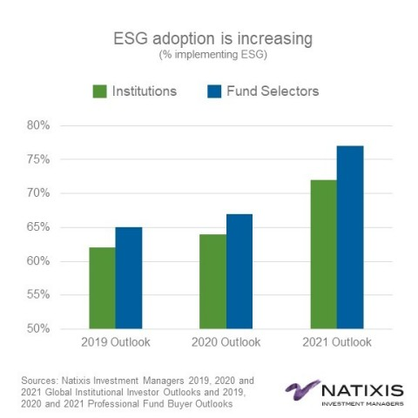
Growing ESG Adoption

Slide 17

Growing ESG Emphasis
Sustainability as an emerging practice area
  Rising demand for ESG investing
    Increasing investor appetite for sustainable, eco-friendly businesses
  Growing popularity of green finance
    E.g. Sustainability-linked loans where borrower enjoys better loan terms such as reduced interest rates if it satisfies specified sustainability performance targets
Sustainability as a business imperative for law firms
  Many businesses, including law firms, are stepping up their ESG commitments
  Pro bono and community engagement
  Going green
  Promoting diversity and inclusion

Slide 18
Sustainability
Panel Discussion

Slide 19
TALENT

Slide 20

Talent
Talent Retention and the “Great Resignation”
PwC’s Global Workforce Hopes and Fears Survey 2022: One in five workers say they are likely to switch jobs in the next 12 months
  Reasons include higher pay and greater job fulfilment
Employee wellbeing has grown in priority in the post-pandemic world
  Some employers are supportive of employees going on sabbaticals to refresh and recharge
  Active steps to attract and retain talent
  Flexible working arrangements
  Welfare and emphasis on employee experience
  Engaging employees to give feedback
  Restructuring benefits to promote retention
  Other initiatives to mitigate stress caused by the
  pandemic and remote working

Slide 21

Talent
Mentorship
Good mentorship helps guide young workers into making better and more relevant decisions for their professional careers
Promoting effective mentoring:
Grooming good mentors
Building trust between mentor and mentee
Encouraging younger workers to embrace mentorship and training opportunities

Slide 22
Talent
Panel Discussion

Slide 23
CONCLUSION

Slide 24
Thank You

