Slide 1
The Reparations Debate
The Indian Residential Settlement in Canada
Paterson Law Office
2101 – 13880 – 101 Ave. Surrey, BC, Canada
V3T 5T1
1-604-614-4185
email: david.paterson@patersonlaw.ca
David Paterson, Chair
Indigenous Peoples Committee

Slide 2
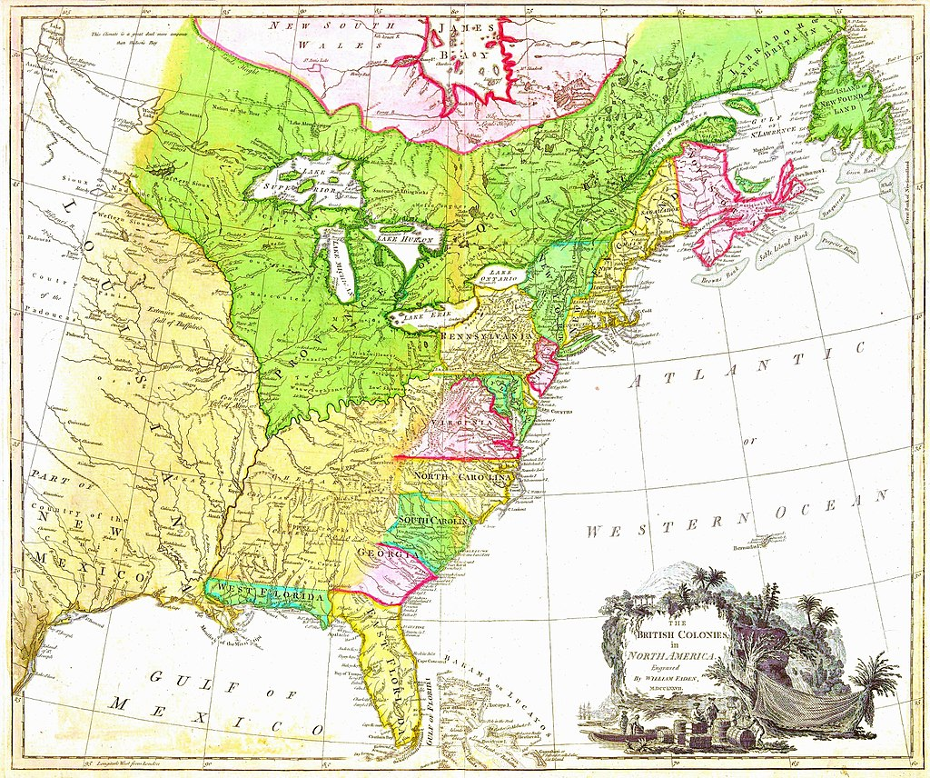
The Beginnings

Slide 3
Royal Proclamation, 1763 … And We do further declare it to be Our Royal Will and Pleasure, for the present as aforesaid, to reserve under our Sovereignty, Protection, and Dominion, for the use of the said Indians, all the Lands and Territories not included within the Limits of Our said Three new Governments, or within the Limits of the Territory granted to the Hudson’s Bay Company, as also all the Lands and Territories lying to the Westward of the Sources of the Rivers which fall into the Sea from the West and North West as aforesaid …

Slide 4
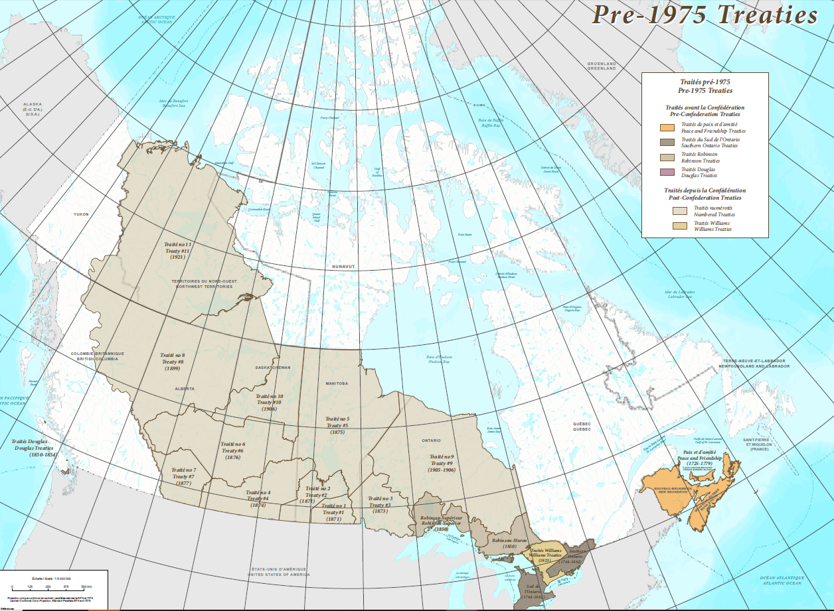

Slide 5
Constitution Act, 1867
Indian Act, 1876

Slide 6
Canada’s Indigenous Policy
“I want to get rid of the Indian problem. [...] Our object is to continue until there is not a single Indian in Canada that has not been absorbed into the body politic, and there is no Indian question, and no Indian Department.”
Duncan Campbell Scott
Deputy Superintendent of Indian Affairs (1913-1932)

Slide 7
Indian Residential Schools
The young Indian learns to read and write, and then goes back to his tribe, and again becomes a savage. The object is to get the young men and the children severed from the tribe as much as possible, and civilise them and give them a trade.
Prime Minister (and Indian Affairs minister) Sir John A. Macdonald (1888)
But in the boarding or industrial schools the pupils are removed for a long period from the leadings of this uncivilized life and receive constant care and attention. It is therefore in the interest of the Indians that these institutions should be kept in an efficient state as it is in their success that the solution of the Indian problem lies.
Deputy Minister of Indian Affairs Hayter Reed (1894)

Slide 9
Indian Residential Schools in Canada (1831-1996) 130 schools, over 150,000 students
Mohawk Institute,
Brantford, Ontario
(opened 1831)
Gordon Residential School,
Punnichy, Saskatchewan
(closed 1996)

Slide 10
Before and After Thomas Moore, 1874
The Canadian government staged dramatic “before and after” photos of Aboriginal children. In the before photo, Thomas Moore, a student in the Regina Indian Industrial School, is dressed as a “savage” holding a revolver. In the after photo, he is “civilized” in his suit. Propaganda like this was used by the Department of Indian Affairs to justify the residential school system. Few knew that both the before and after photos were faked images with no connection to the Cree boy’s real life. Thomas Moore’s “before” clothing includes women’s traditional attire which a male would never wear.
“Residential Schools: with the words and images of Survivors”
- Larry Loyie, Wayne K. Spear, Constance Brissenden

Slide 11
Moving Forward
1998 – Canadian Residential School Plaintiffs’ Counsel Association (CRSPCA) signed Memorandum of Understanding with Assembly of First Nations (AFN)
1998 - Consultative Dialogues nation wide
2000 – Baxter class action commenced by National Consortium
2003 – Alternate Dispute Resolution (ADR) process
February 2005 – Parliamentary Committee hearings
May 2005 – Supreme Court of Canada refused leave to appeal of Cloud v Canada
May 2005 – Political Accord adopted between AFN and Government of Canada
November 24, 2005 – Agreement in Principle to resolve Baxter class action
May 2006 – Indian Residential School Settlement Agreement (IRSSA), effective September 19, 2007

Slide 12
Indian Residential School Settlement Agreement (May 8, 2006)
$1.9 billion - Common Experience Payment (CEP) -
$4 billion compensation paid out - Independent Assessment Process (IAP)
Indian Residential Schools Truth and Reconciliation Commission (National Centre for Truth and Reconciliation)
$20 million - Funding for Commemoration Projects
$250 million - Health and Healing Services (Aboriginal Healing Foundation)

Slide 13
The government of Canada sincerely apologizes and asks the forgiveness of the Aboriginal peoples of this country for failing them so profoundly. We are sorry. - Prime Minster S. Harper, June 11, 2008
Image credit – The Canadian Press: Fred Chartrand

Slide 14
Pope Francis Visit to Canada July 24-30, 2022
Maskwacis, Alberta, Canada July 25, 2022
(REUTERS/Amber Bracken)
Ceremonial Cloth with 2800 names of children who died at IRS
(CNS photo – Paul Haring)

Slide 15
94 Calls to Action
Legacy
Child Welfare
Education
Language and Culture
Health
Justice
Reconciliation
Canadian Governments and the United Nations Declaration on the Rights of Indigenous People
Royal Proclamation and Covenant of Reconciliation
Settlement Agreement Parties and the United Nations Declaration on the Rights of Indigenous People
Equity for Aboriginal People in the Legal System
National Council for Reconciliation
Professional Development and Training for Public Servants
Church Apologies and Reconciliation
Education and Reconciliation
Youth Programs
Museums and Archives
Missing Children and Burial Information
National Centre for Truth and Reconciliation
Commemoration
Media and Reconciliation
Sports and Reconciliation
Business and Reconciliation
Newcomers to Canada

Slide 16
Reconciliation Canada – Walk for Reconciliation 2013

Slide 17
The Reparations Debate
The Indian Residential Settlement in Canada
Paterson Law Office
2101 – 13880 – 101 Ave. Surrey, BC, Canada
V3T 5T1
1-604-614-4185
email: david.paterson@patersonlaw.ca
David Paterson, Chair
Indigenous Peoples Committee

