Slide 1

The International Bar Association
Arbitration Committee

Slide 2
I. Why the IBA?

Slide 3
I. Why the IBA?
With so many organizations vying for your participation, why choose the IBA Arbitration Committee?
It’s simple, really!
The Arbitration Committee is the premiere networking organization in the world for the arbitration community.
While other arbitration organizations are connected to an arbitral institution or regionally focused, the IBA has a truly global mandate.
We bring together arbitration lawyers from across the globe to define and shape the future of international arbitration together.

Slide 4
I. Why the IBA?
The Arbitration Committee’s work encompasses a wide scope of projects and mandates, including studying new areas of arbitral practice and developing reports, engaging with in-house counsel, arbitral institutions and regional bodies.
We maintain a widely used set of arbitration guidelines and rules implemented by tribunals world-wide and are considered to reflect the most globally relevant and cutting-edge guidelines for arbitral practice.

Slide 5
II. Background and
Core Benefits of
IBA Membership

Slide 6
II. Background and Core Benefits of IBA Membership
IBA Background
The International Bar Association, the global voice of the legal profession, is the foremost organization for international legal practitioners, bar associations and law societies.
Established in 1947, shortly after the creation of the United Nations, with the aim of protecting and promoting the rule of law globally, it was born out of the conviction that an organization made up of the world’s bar associations could contribute to global stability and peace through the administration of justice.

Slide 7
II. Background and Core Benefits of IBA Membership
IBA Background
In the years since its creation, the organization has evolved from an association comprised exclusively by bar associations and law societies, to one that incorporates individual international lawyers and entire law firms.
The present membership is comprised of more than 80,000 individual international lawyers from most of the world’s leading law firms and some 190 bar associations and law societies spanning more than 170 countries.

Slide 8
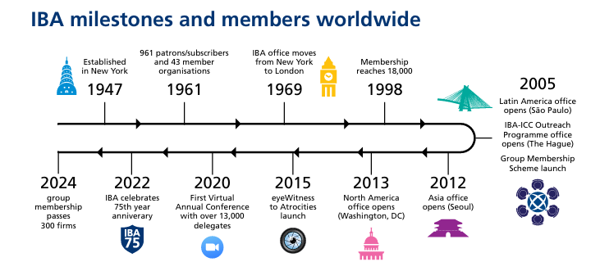
II. Background and Core Benefits of IBA Membership
IBA Background

Slide 9
II. Background and Core Benefits of IBA Membership
The IBA Serves and Influences the Global Legal Community
The IBA has considerable expertise in providing assistance to the global legal community, and through its global membership it influences the development of international law reform and shapes the future of the legal profession throughout the world.
The IBA acts as a connector, enabler and influencer, for fair practice and accountability worldwide. The IBA has collaborated on a broad range of ground-breaking, international projects with the United Nations, the European Parliament, the Council of Europe, the Commonwealth, the OECD, the WTO, the International Monetary Fund, the World Bank, among others.

Slide 10









II. Background and Core Benefits of IBA Membership
Collaboration with Leading Global Organizations

Slide 11
II. Background and Core Benefits of IBA Membership
Attend Conferences and Events Across the Globe
Free webinar
attendance
Attend 50+ yearly events worldwide
Discount fees for conference registration
IBA annual conference, comprising 6,000+ attendees
Specialist conferences regarding specific areas of practice

Slide 12
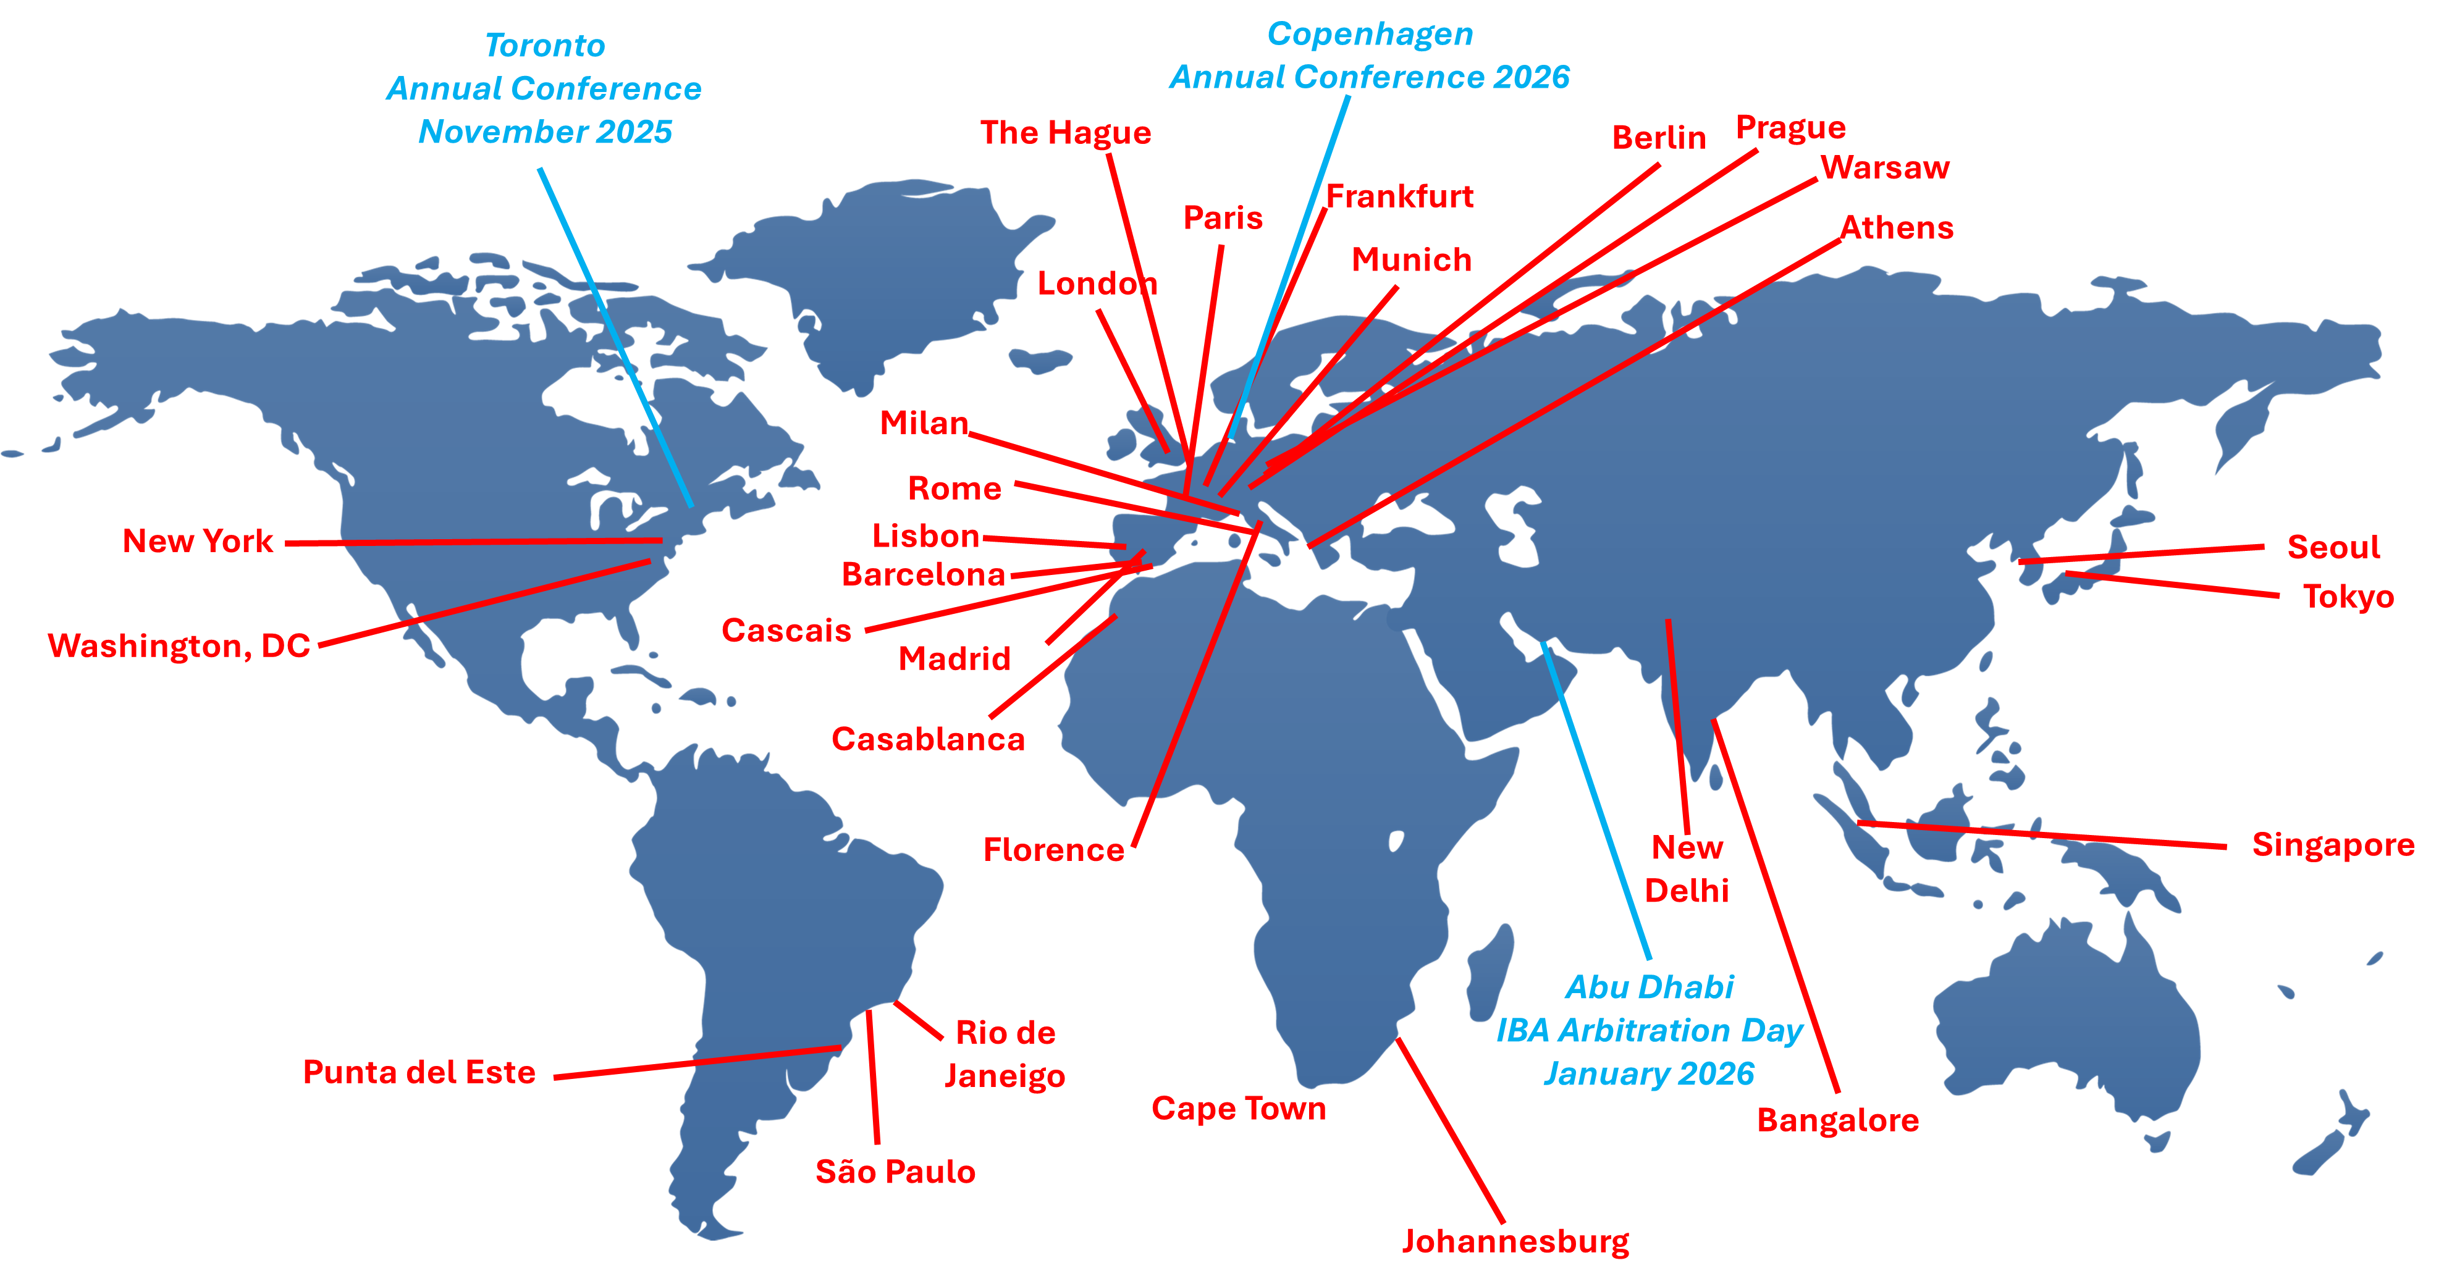
II. Background and Core Benefits of IBA Membership
Attend Conferences and Events Across the Globe

Slide 13
II. Background and Core Benefits of IBA Membership
Build your Global Network
Cost-effective forum for global networking.
Participate in one or more of dozens of specialized groups/committees focused on discrete practice areas.
Access to the IBA Directory - Grants Access to IBA Journals, Committee contents, discounts on books, and network with 80,000+ professionals worldwide!
Build connections with leading international practitioners.
Receive up-to-date insights from practitioners worldwide.
Attend conferences at discounted rates and dozens of free webinars.
Build and maintain a public profile to enhance your recognition.

Slide 14
II. Background and Core Benefits of IBA Membership
Access Specialized Research and Resources
Publications, committee updates.
Webcasts, podcasts, films.
Training sessions.
The world’s largest international legal resource centers, with experts contributing to it on a regular basis.
IBA Website: Gain access to the totality of the tools available for IBA Members at our website, the main hub to stay in touch with fellow practitioners and to be up to date with news regarding events and the works of the committees, subcommittees, working groups and regional groups.

Slide 15
III. The IBA Arbitration
Committee

Slide 16
III. The IBA Arbitration Committee
The Committee focuses on substantive and procedural law relating to transnational arbitration.
  Its mission is to share information and promote the use and improve the effectiveness of international arbitration. For this, it includes tools such as its Library of Products: 24/7 remote access from anywhere in the world to IBA’s eDatabases.
  The Arbitration Committee has contributed landmark works such as the 2024 Guidelines on Conflicts of Interest in International Arbitration and the 2020 Rules on the Taking of Evidence in International Arbitration
  IBA Arbitration Committee members benefit from unique networking opportunities, discounts on conferences and possibilities of writing IBA publications and involvement in the Committee’s work

Slide 17



Chiann Bao
Senior Co-Chair
Kate Brown de Vejar
Junior Co-Chair
Dietmar W Prager
Senior Vice-Chair
Committee Officers
Andre Abbud
Vice-Chair
Michelangelo Cicogna
Vice-Chair
Alexandra C Johnson
Vice-Chair
Sara Koleilat-Aranjo
Vice-Chair
Mimi M Lee
Vice-Chair
Caline Mouawad
Vice-Chair
Patricia Saiz
Vice-Chair
Thomas Voisin
Vice-Chair
Mikal Brøndmo
Secretary
Kent Philips
Treasurer
Jennifer L Permesly
Diversity and Inclusion Officer
Amr Omran
Conference Quality Officer
Sylvia Tonova
Publication and Newsletter Editor
Zelda Hunter
Newsletter Editor
Huawei Sun
Asia Pacific Regional Forum Liaison Officer
Rafal Morek
Website Officer
Felipe Ossa
Membership Officer
Amir Singh Pasrich
Ira Nishisato
LPD Council Liaison Officers
ESG Arbitration Subcommittee
IBA Arb40 Subcommittee
IBA Arbitration Guidelines and Rules Subcommittee
International Commercial Arbitration Case Law Subcommittee
Investment Arbitration Subcommittee
Recognition and Enforcement of Arbitral Awards Subcommittee
Arbitration News Working Group
In-House Counsel Working Group
Insolvency and International Arbitration Working Group
Site Visit Protocol Working Group
Sports Arbitration Working Group
Working Groups
Regional Groups
Africa
Asia Pacific
Eastern Europe
Latin America

Slide 18
III. The IBA Arbitration Committee
Attend the Committee’s Events Worldwide
IBA Annual Conference
Toronto 2025 - Special Events
IBA Arbitration Day
Every Year in a Different Location
Webinars Organized by the Committee
Past & Upcoming Webinars
Arbitration Committee Breakfast
24th Edition (2023): Lisbon
Ethical & Professional Rules for Counsel & Arbitrators
Panels on the (Controversial) Role of Experts
25th Edition (2024): Singapore
Series on Litigation in Latin America
Hot Topics in International Arbitration
26th Edition (2025): London
Importance of Being Social
Plus!
The Burden of Proof in ESG
27th Edition (2026):
Abu Dhabi
Regional Tax Updates for Asia Pacific
Plus!
New Energy Disputes
Young Lawyers & Leadership
Attend IBA Arbitration Town Hall Meetings.
Arbitration Committee’s Open Business Meeting & Many Others!
Women Leaders in Healthcare & Life Sciences
Members allowed & encouraged to participate as speakers, attendees & to contribute ideas for future events

Slide 19
III. The IBA Arbitration Committee
Global Networking
General IBA Membership guarantees membership of the “Public and Professional Interest Division (“PPID”), with one free committee and regional forum.
Full IBA Membership also includes membership of the Legal Practice Division (“LPD”) and of one specialist legal committee in the LPD.
Meet in-house lawyers through the Arbitration Committee’s In-House Counsel Group.
Follow and connect with the IBA’s Linkedin page and expand your connections
Access the IBA’s Directory: 3000+ Members!

Slide 20
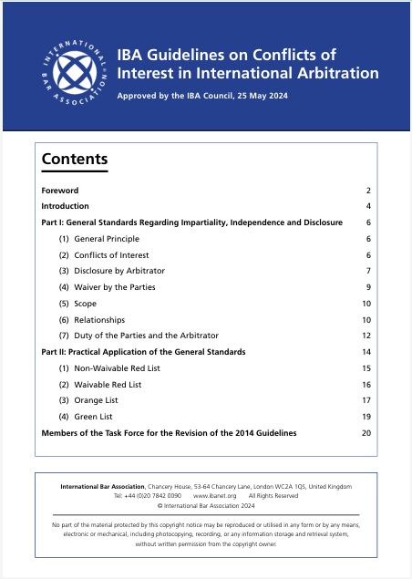
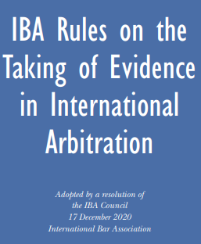
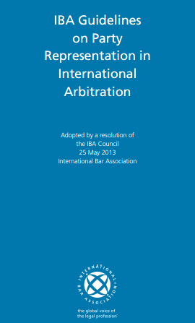
III. The IBA Arbitration Committee
Rules and Guidelines
  We maintain, update and revise the rules used by parties around the world!

Slide 21
III. The IBA Arbitration Committee
Relevant Works
  Relevant Works of the IBA Arbitration Committee in 2024 and 2025
Update of the IBA Rules on the Taking of Evidence in International Arbitration (including multiple translations and commentaries)
Insolvency and Arbitration Toolkit; Report on Insolvency and Arbitration
Site Visit Model Protocol for International Arbitration
Report on Uniform Guidelines on Privilege
Validity of Arbitral Awards – Country Reports
Arbitral Awards and Non-Signatories – Country Reports
Country-by-Country Guides to Arbitration
Report on Res Judicata in International Arbitration

Slide 22
III. The IBA Arbitration Committee
Active Projects
  IBA Arbitration Committee 2025 Active Projects
Promotion, monitoring and analysis of potential reform or additions to IBA Guidelines.
Publication of reports regarding international arbitration case law on substantive issues.
Promotion of investment treaty arbitration.
Addressing issues arising under the New York Convention.
Update of Toolkit on Insolvency and Arbitration, covering additional jurisdictions.
Report on issues arising from the intersection of insolvency and investment arbitration.
Report on ESG clauses and the use of dispute resolution clauses in ESG disputes.
Cultivation of networking and promotion of the Committee and subcommittees worldwide.
Comparative global analysis of sports arbitration panels.
Constitution of Expanded Task Force on res judicata, for the development of an autonomous res judicata standard.
Constitution of a working group to develop potential set of guidelines for experts involved in international arbitration proceedings.

Slide 23
III. The IBA Arbitration Committee
Several Working Groups Currently Address Key Issues World-Wide
IBA Regional Arbitration Groups | IBA Diversity and Inclusion Council
The IBA Arbitration Committee comprises several regional arbitration groups, which seek to promote the Committee’s Works in said regions, encouraging practitioners from every corner of the world to participate in IBA activities. They also support networking opportunities, especially with national and regional arbitration institutions, disseminate and promote IBA Guidelines and deepen the role practitioners in the Committee’s activities. These groups are further detailed in the next slides of this presentation. These include: Eastern Europe Arbitration Group Latin America Arbitration Group Africa Arbitration Group Acia Pacific Arbitration Group | The IBA’s Diversity and Inclusion Council is the working group mandated with the promotion of diversity, equality, respect and inclusion, for the IBA to ensure the protection of all people part of the association, in line with human rights protection and the principles of justice, integrity and equity. The foregoing is the expression of the IBA’s commitment towards creating a fair and just organization, establishing a culture of inclusion and support for all members and the elimination of discrimination and bias of every sort.
 | AI and Arbitration
 | The Arbitration Committee also comprises an IA and Arbitration Task Force, which seeks to explore how the organization can adapt to artificial intelligence revolution. For this, six working groups have been created, for the evaluation of each phase of an arbitral proceeding and drafting of proposals for how AI can be integrated to help and complement the work that arbitration lawyers perform when participating in arbitration procedures.

Slide 24
III. The IBA Arbitration Committee
Several Working Groups Currently Address Key Issues World-Wide
IBA Subcommittees | IBA Working Groups
ESG Arbitration: Devoted to the preparation of Report on ESG Clauses and the use of dispute resolution clauses in ESG disputes with a particular focus on arbitration. IBA Arb40: Seeks to engage actively with younger members of the arbitration community, organizes symposia and focuses on thought leadership. IBA Arbitration Guidelines and Rules: Promotes the IBA Guidelines and Rules, monitors their use and considers potential revisions and additions. International Commercial Arbitration Case Law: Collects international commercial arbitration decisions and periodically publishes reports about international arbitration case law on substantive legal issues of importance to the international arbitrator’s community. Investment Arbitration: Studies and promotes investment treaty arbitration. Recognition and Enforcement of Arbitral Awards: Addresses issues arising under the 1958 New York Convention on Recognition and Enforcement of Foreign Arbitral Awards. | Arbitration News Group: Prepares the IBA Arbitration Newsletter and ad hoc publications of the committee. Sports Arbitration Group: Works on comparative analysis of sports arbitration panels around the world.
 | AI and Arbitration
 | In-House Counsel Group: Informs in-house counsel about the work of the Arbitration Committee; seeks input and forms a safe platform for in-house counsels from the world to engage in a discussion on arbitration practices. Insolvency and International Arbitration Group: Prepares, updates and publicizes the Toolkit on Insolvency and Arbitration. Prepares reports on issues arising from the intersection between insolvency and investment arbitration.

Slide 25
FAQ
How do I join the IBA?
Just follow the steps provided in this link!
Can I pay a discounted rate for my membership?
Discounted rates are available for full-time academics, judges, government lawyers, retired lawyers and lawyers from low-income countries. Check if your country is eligible here.
Can I pay my membership online?
Absolutley, any outstanding invoices can be found in the ‘Manage Account’ section of your MyIBA or at the top of your MyIBA home page

Slide 26


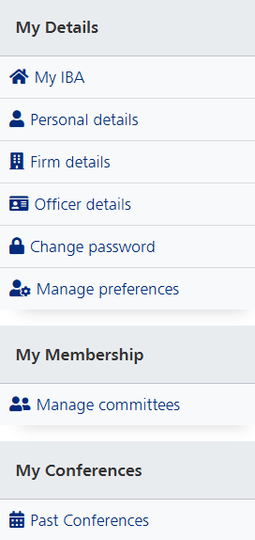

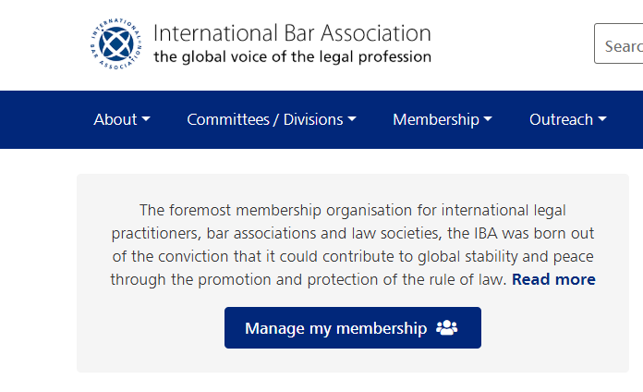

FAQ
How do I join the IBA Arbitration Committee?
Simply go to the ‘Manage committees’ tab in the ‘Manage my membership’ section, and tick the Arbitration Committee box.
If you have any questions, do not hesitate to contact our Membership Officer, Felipe Ossa (fossa@claro.cl)

Slide 27
FAQ
How do I get involved as an officer of the Arbitration Committee?
Contact our Co-Chairs Chiann Bao (chiann.bao@arb-boutique.com) and Kate Brown de Vejar (kate.browndevejar@dlapiper.com).
How do I get involved with a Subcommittee?
You can find contact details for all Subcomittee officers here.
How can I suggest ideas and who do I contact?
The Arbitration Committee is always open to suggestions and proposals! You can contact either our Co-Chairs or the Chairs for each Subcommitee (see contact details here).

Slide 28

The International Bar Association
Arbitration Committee
For further information, make sure to check out the IBA’s website: www.ibanet.org
And the Arbitration Committee’s subdomain!

